Slide 1
Fetal and neonatal circulation

Slide 2
Rudolph congenital heart diseases

Slide 3
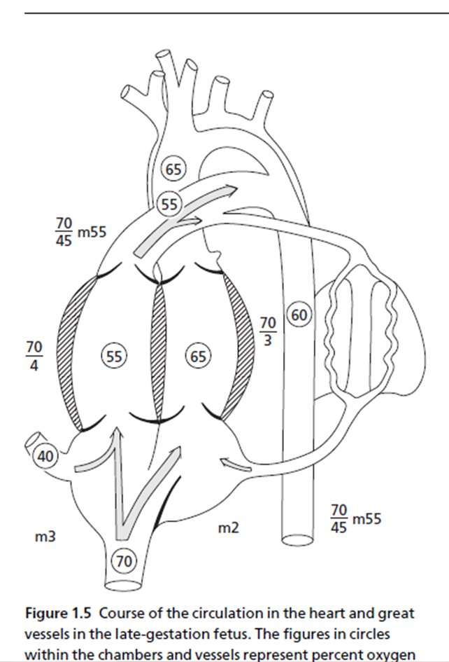

Slide 4
PVR in FETUS is high
In the fetus and newborn, all small pulmonary arteries have a thicker medial smooth muscle layer in relation to diameter than similar arteries in adults.
This increased muscularity is partly responsible for the increased vasoreactivity and pulmonary vascular resistance in the fetus, particularly near term.

Slide 5
What happens at birth?
The change from fetal to postnatal circulation happens very quickly.
Changes are initiated by baby’s first breath.

Slide 6
What are the changes?
1. Decrease in pulmonary vascular resistance
2. Disruption of the umbilical-placental circulation – SVR increases
3. Abruptly at birth, the ductus arteriosus changes from a right-to-left conduit of blood to the descending aorta, to a left-to-right conduit of blood to the lungs

Slide 7
Pulmonary circulation
Breathing at birth is associated with a marked fall in PVR and rise in PBF. – oxygen
PA pressure does not fall as rapidly and remain elevated till the ductus is widely patent.
Once the ductus is closed, PA pressure can vary independent of systemic pressure.

Slide 8
The transitional circulation
After the initial rapid decrease in pulmonary vascular resistance and pulmonary arterial blood pressure, there is a slow, progressive decrease, with adult levels reached after 2 to 6 weeks.
This is due to vascular remodeling, muscular involution, and rheologic changes.
In the first 4 to 6 weeks after birth, there is progressive involution of the circumferential medial smooth muscle with overall reduction in medial muscular thickness of the walls of the small pulmonary arteries

Slide 9
Ductus arteriosus closure – physiological
Immediately after birth, contraction and cellular migration of the medial smooth muscle in the wall of the ductus arteriosus produce shortening, increased wall thickness, and protrusion into the lumen of the thickened intima (intimal cushions or mounds), resulting in functional closure .
This commonly occurs within 12 hours after birth in full-term human infants

Slide 10
Ductus arteriosus closure – anatomic
Completed by 2 to 3 weeks in human infants, produced by infolding of the endothelium, disruption and fragmentation of the internal elastic lamina, proliferation of the subintimal layers, and hemorrhage and necrosis in the subintimal region.
The mounds enlarge progressively, and there is connective tissue formation and replacement of muscle fibers with fibrosis and permanent sealing of the lumen to produce the ligamentum arteriosum

Slide 11
Ductus arteriosus closure – mechanism
The increased level of oxygen probably causes vasoconstriction of the ductal musculature,
Reduction in circulating prostaglandins of the E series plays a role
Maturity of the newborn are important factors in closure of the ductus.
Acetylcholine and bradykinin also constrict the ductus.

Slide 12
Closure of the foramen ovale
Passive - secondary to alterations in the relative return of blood to the right and left atria
At birth combined ventricular output returning from the lung changes from 8% prenatally to >50%
Left atrial pressure thus exceeds right, and the redundant flap of tissue of the foramen ovale that previously bowed into the left atrium is now pressed against the septum
Closes shortly after birth, fuses completely in first year.

Slide 13
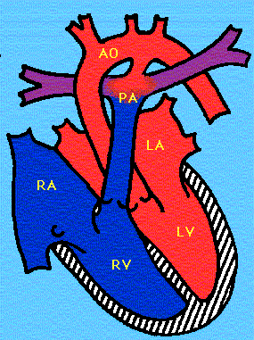
Flow from RV to
descending
Aorta via ductus,
PA’s tiny
Ductal flow
reverses, Branch
PA’s open up
Ductus closes,
Then PVR
drops (2mos)
Fetal Circulation
8 Hours old
24 hrs
Notes:
Tiny PA’s open up
Ductal flow reverses
PVR decreases over 6-8 weeks

Slide 14
HEART FAILURE IN NEWBORN

Slide 15
CHF WITH NO CARDIAC MALFORMATIONS
PRIMARY CARDIAC
Cardiomyopathy
Myocarditis
Cardiac ischemia
Acquired valve disorders
Hypertension
Kawasaki syndrome
Arrhythmia
(bradycardia or tachycardia)
NONCARDIAC
Anemia
Sepsis
Hypoglycemia
Diabetic ketoacidosis
Hypothyroidism
Other endocrinopathies
Arteriovenous fistula
Renal failure
Muscular dystrophies

Slide 16
CLINICAL MANIFESTATIONS IN INFANTS WITH HF
Feeding difficulties
Rapid respirations
Tachycardia
Cardiac enlargement
Gallop rhythm (S3)
Hepatomegaly
Pulmonary rales
Peripheral edema
Easy fatigability.
Sweating
Irritability
failure to thrive.

Slide 17
Feeding difficulties & increased fatigability
Often it is noticed by mother
Interrupted feeding (suck- rest -suck cycles)
Infant pauses frequently to rest during feedings
Inability to finish the feed, taking longer to finish each feed (> 30 minutes)
Forehead sweating during feeds –due to activation of sympathetic nervous system –a very useful sign
Increasing symptoms during and after feedings

Slide 18
Rapid respirations
Tachypnea
> 60/min in 0-2mth
>50/mt in 2mth to 1yr
>40/mt 1-5 yr in calm child
Grunting (a form of positive end-expiratory pressure)
In cyanotic heart disease rapid respirations may be due to associated brain anoxia and not CHF -treatment for these two conditions is entirely different
Happy tachypnea- tachypnea with out much retractions
Fever especially with a pulmonary infection may produce rapid respirations.

Slide 19
Tachycardia
Rate is difficult to evaluate in a crying or moving child
Tachycardia in the absence of fever or crying when accompanied by rapid respirations and hepatomegaly is indicative of HF
Persistently raised heart rate > 160 bpm in infants
> 100 bpm in older children.
Consider SVT if heart rate > 220 bpm in infants and > 180 bpm in older children.

Slide 20
MODIFIED ROSS HEART FAILURE CLASSIFICATION FOR CHILDREN
Class I
Asymptomatic
Class II
Mild tachypnea or diaphoresis with feeding in infants
Dyspnea on exertion in older children
Class III
Marked tachypnea or diaphoresis with feeding in infants
Marked dyspnea on exertion
Prolonged feeding times with growth failure
Class IV
Symptoms such as tachypnea, retractions, grunting, or diaphoresis at rest

Slide 22
CHF on first day of life
Myocardial dysfunction secondary to asphyxia, hypoglycemia, hypocalcaemia or sepsis are usually responsible for CHF on first day
Few structural heart defects cause CHF within hours of birth
HLHS, severe TR or PR, Large AV fistula
TR secondary to hypoxia induced papillary muscle dysfunction or Ebstein’s anomaly of the valve
Improves as the pulmonary artery pressure falls over the next few days

Slide 23
CHF in first week of life
Critical AS or PS
Obstructive TAPVC
Adrenal insufficiency due to enzyme deficiencies or neonatal thyrotoxicosis could present with CHF in the first few days of life
TGA
no VSD -1ST week
VSD and no PS-6-8 weeks

Slide 24
CHF beyond second week of life
Most common cause of CHF in infants is VSD
Presents around 6-8 weeks of age.
Left to right shunt increases as the PVR falls
Murmur of VSD is apparent by one week
Full blown picture of CHF occurs around 6-8 weeks.
Other left to right shunts like PDA present similarly
Fall in PVR is delayed in presence of hypoxic lung disease and at high altitude and can alter the time course
Spontaneous improvement in CHF -development of obstructive pulmonary arterial hypertension even in early childhood

Slide 25
Cyanotic heart disease in newborn

Slide 26
Cyanosis at birth
d TGA

Slide 27
Cyanosis < 1 week
D TGA
Pulmonary Atresia
Tricuspid atresia
Ebstein
Critical PS

Slide 28
Cyanosis > 1 week
TOF
TGA
Admixture lesions
TAPVC
SV
DORV
Truncus

Slide 29
 | cardiac | respiratory
HEART RATE | FASTER | FAST
RESPIRATORY RATE | FAST | FASTER
GRUNT | ABSENT | PRESENT
MURMUR | PROMINENT | CAN BE PRESENT
CHF | PRESENT | LESSLIKELY
ABNORMAL PULSE | YES | NO
RESPONSE TO O2 | NOT MUCH | GOOD

Slide 30
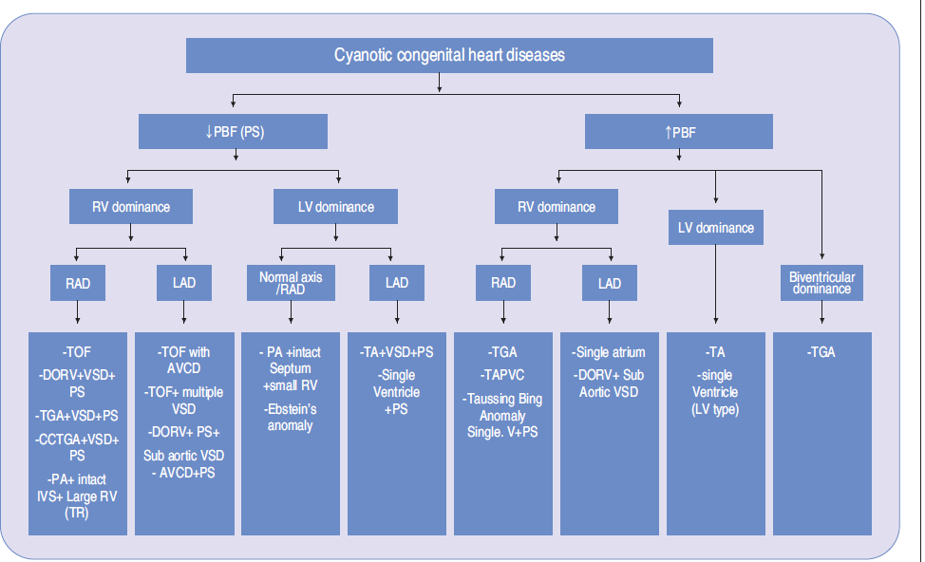

Slide 31
CCHD in Newborns: Clues based on presentation
Cyanosis
No Resp Distress
Cyanosis
+
Resp Distress
Shock
Differential
cyanosis
TGA
DDPC
TAPVC
obstructed
DDSC

Slide 32
Admixture Physiology

Slide 33
Definition
Complete mixing
Deoxygenated systemic venous blood
Fully oxygenated pulmonary venous blood
In a common receiving chamber
Resultant saturation in between that of SV and PV

Slide 34
Common lesions
TAPVC
Common atrium
Atresia of one of the atrioventricular valves (Tricuspid atresia, mitral atresia),
Single ventricle physiology (double inlet ventricle),
Semilunar valve atresia
Pulmonary atresia including hypoplastic right heart syndrome,
Aortic atresia including hypoplastic left heart syndrome),
Double outlet RV or double outlet LV
Truncus arteriosus.

Slide 35
Why there is increased pulmonary blood flow in admixture lesions.
Normaly
Systemic blood flow is maintained within a narrow physiological range through various neurohumoral mechanisms.
Pulmonary circulation does not possess such an efficient neurohumoral mechanisms
Pulmonary circulation controlled by the dominant systemic circulation as the two are in series
In admixture lesions
Low pulmonary vascular resistance-1/10 of systemic- cause increase PBF

Slide 36
PVR

Slide 39
Drugs for vasodilatory testing
DRUG | DOSE | DURATION | COMMENTS
Inhaled NO | 10 – 80 PPM | 5-10 MIN | DOC, SINGLE ONLY
ADEENOSINE | 50 – 500 UG/KG/MIN | 10-15 MIN | MULTIPLE PULSES
EPOPROSTENOL | 2-12 NG/KG/MIN | 10-15 MIN | COSTLY
OXYGEN | 100 % | 10-15 | COMBINED WITH NO

Slide 40
NO
Advantages
- No ↑ in syst. sat.
- No systemic hypotension
- No arterial hypoxemia
Disadvantages
- Methaemoglobinemia
- Pulmonary edema
- Lung injury

Slide 41
NO vs NO + Oxygen combination
Number of responders with combination significantly > than when NO/Oxygen used alone.
Combination of NO + 02 provides add’nal pulmonary vasodilatation & can rapidly identify patients with pulmonary vasoreactivity.
Good postoperative results
Lock et al , JACC 2000

Slide 42
Positive pulmonary vasodilator test
Current recommended definition of a positive test.
Decrease in mPAP of at least 10 mmHg to an absolute level below 40 mmHg with preserved or increased CO.
Previous
Decrease in PVR >20%

Slide 43
Treatment in Cath Lab for CHD
Atrial Septostomy
Stent Ductus
Ductal Closure
Pulmonary and Aortic Balloon valvuloplasty
ASD, VSD closure
Stent pulmonary arteries

Slide 44
Pulmonary hypertension
Hyperkinetic Obstructive
Heart size large normal (except in ASD)
Parasternal hyperkinetic forcible or heaving in ASD
impulse mild in VSD & PDA
Click of PAH absent present
Second sound ASD‑wide & fixed ASD - wide and fixed
(P2 accent‑ VSD‑wide & variable VSD - single
uated in both) PDA‑paradoxically PDA - normal
split
Shunt murmur loud short or absent
Flow murmur present absent

